Slide 2
LO1, key terms
Describe the structure and function of the endocrine system
Define the following terms:
gland
an organ that produces and secretes chemicals called hormones.
hormone
a chemical substance created by the body that controls body functions.

Slide 3
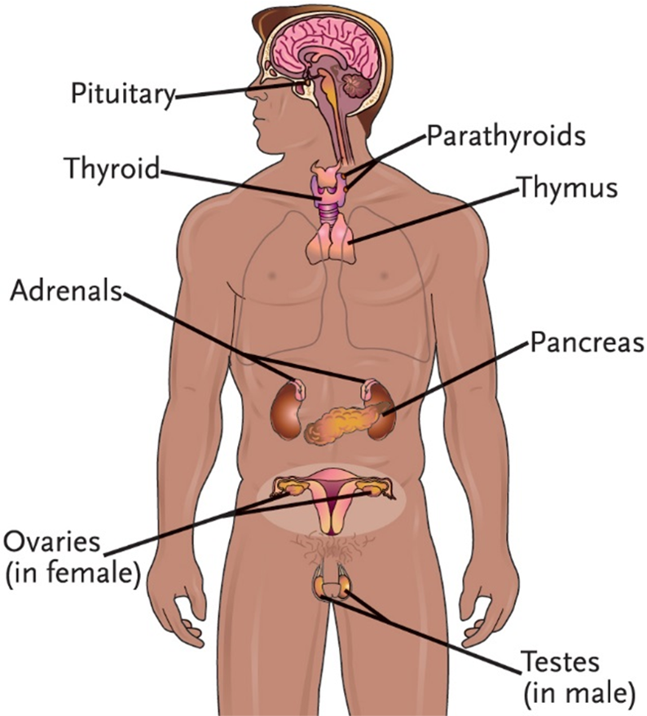
LO1, content 1
Key Material 17-1: The Endocrine System

Slide 4
LO1, content 2
Describe the structure and function of the endocrine system
Review these points about the endocrine system:
Glands secrete hormones, which are chemical substances that control numerous body functions
Hormones are carried by the blood to organs in order to achieve the following:
Maintain homeostasis through hormone secretion
Influence growth and development
Maintain blood sugar levels
Regulate calcium and phosphate levels
Regulate the body’s ability to reproduce
Determine how fast cells burn food for energy

Slide 5
LO1, content 3
Describe the structure and function of the endocrine system
Normal changes of aging include the following:
Decreased levels of hormones, such as estrogen and progesterone
Less production of insulin
Body is less able to handle stress

Slide 6
LO2, key term
Discuss common medications used to treat diabetes
Define the following term:
diabetes
a condition in which the pancreas produces too little insulin or does not properly use insulin.

Slide 7
LO2, content 1
Discuss common medications used to treat diabetes
Treatment for type 1 diabetes includes the following:
Daily insulin (by subcutaneous injection, pump, or inhalation)
Inhalation form is contraindicated for residents with asthma or COPD
Regular glucose testing (usually by finger stick)
Special diet
Medication aides in most states cannot administer subcutaneous injections; in some states they may administer predrawn (already measured into the syringe) insulin with appropriate training
MAs in some states/some facilities are allowed to perform glucose testing
Table on textbook p. 165 (or handout) details specific drugs

Slide 8
LO2, content 2
Discuss common medications used to treat diabetes
Understand the following about treatment for type 2 diabetes:
May be controlled/managed with diet
Antidiabetic drugs work in these ways:
By decreasing glucose production and/or absorption
By increasing the release of insulin
By increasing the body’s sensitivity to insulin
By a combination of these actions
Some antidiabetic drugs have serious side effects/boxed warnings (see table)
Blood glucose and HbA1c (measurement of average glucose levels over a 2–3 month period) are monitored regularly
Insulin may be needed if diet and antidiabetic drugs do not control blood glucose
Table on textbook pp. 165–166 (or handout) details specific drugs

Slide 9
LO2, content 3
Discuss common medications used to treat diabetes
Care guidelines for diabetes include the following:
Perform blood tests as directed/allowed
Administer all medications exactly as ordered. Do not provide food/beverages other than water unless indicated in the MAR
Be familiar with the side effects of any oral antidiabetic medications you administer. Report immediately if residents show signs of serious adverse effects

Slide 10
LO2, content 4
Discuss common medications used to treat diabetes
Care guidelines for diabetes (cont’d):
Insulin reaction (hypoglycemia) is a complication of diabetes that can be life-threatening. A resident experiencing insulin reaction needs to receive glucose quickly (glucose tablets/gel, juice, milk, honey, or some form of sugar. Signs/symptoms to report immediately include
Feeling weak or different
Nervousness
Shaking
Dizziness
Perspiration

Slide 11
LO2, content 5
Discuss common medications used to treat diabetes
Care guidelines for diabetes (cont’d):
Diabetic ketoacidosis (DKA) is a dangerous complication caused by too little insulin in the body. Signs and symptoms to report immediately include
Increased hunger, thirst, or urination
Abdominal pain
Deep or labored breathing
Breath that smells sweet or fruity

Slide 12
LO3, key terms
Discuss common medications used to treat thyroid disorders
Define the following terms:
hyperthyroidism
a condition in which the thy­roid produces too much thyroid hormone, caus­ing body processes to speed up, resulting in rapid heartbeat, sweating, weight loss, and nervousness.
hypothyroidism
a condition in which the body lacks thyroid hormone, causing the body pro­cesses to slow down and resulting in fatigue, weight gain, constipation, and intolerance to cold.

Slide 13
LO3, content 1
Discuss common medications used to treat thyroid disorders
Treatment for hyperthyroidism includes the following:
Radioactive iodine (not administered by MAs)
Surgery to remove part of the thyroid gland
Oral medications to slow the release of thyroid hormone
Can cause liver damage; regular blood tests required
Table on textbook p. 165 (or handout) details specific drugs

Slide 14
LO3, content 2
Discuss common medications used to treat thyroid disorders
Treatment for hypothyroidism includes the following:
Thyroid replacement therapy
Levels must be monitored regularly to ensure the proper dose
If dose it too high, can cause increased heart rate, palpitations, sweating, weight loss, irritability
Table on textbook p. 165 (or handout) details specific drugs

Slide 15
LO3, content 3
Discuss common medications used to treat thyroid disorders
Remember these care guidelines for thyroid disorders:
Always administer thyroid medications at the time ordered. Thyroid hormone replacement medications are not absorbed well unless the stomach is empty. Administer 60 minutes before breakfast or at bedtime, at least 3 hours after the last meal
Carefully check dosage listed on the MAR. Dosage may be adjusted based on blood test results

